Slide 1
Strategy & BA: Four Scenarios
Business Intelligence & Analytics

Slide 2
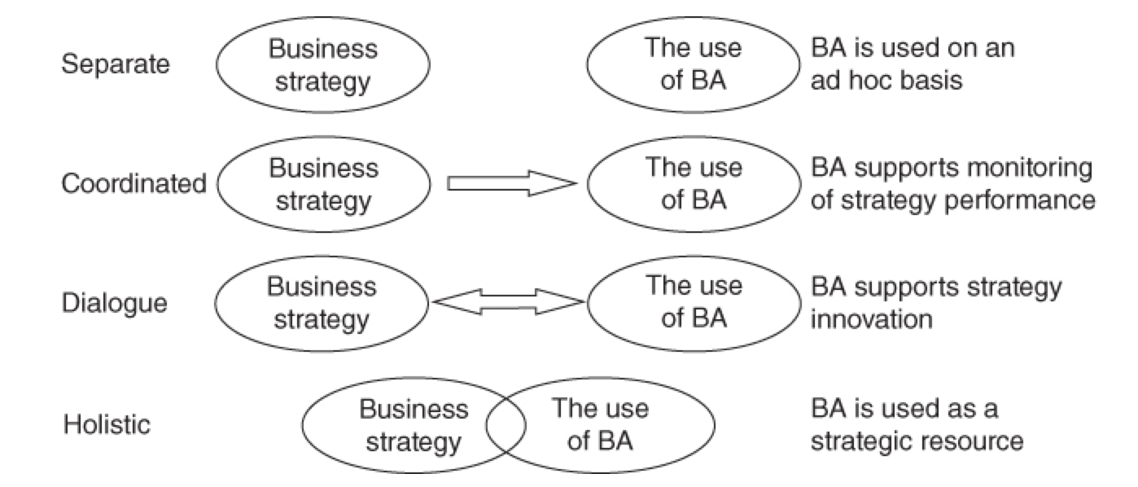
Integrating BA and strategy
Four scenarios represent maturity, ability and willingness to work with information at different levels.
Differences not a matter of “good” to “bad”
Option exists to take steps toward next phase or move to a strategy that is less dependent on information.

Slide 3
Scenario 1 : separate
Conditions
Company has no data
Company has limited data distributed over a large number of systems
Typically unable to make a connection between data and strategy
How is data used?
Not used for strategic decision making
In connection with ad hoc requests
Potentially to automate processes
Used with no link to business strategy (tactical decisions only)

Slide 4
Strategy
Sales
Analytics
Production
Mktg

Slide 5
Strategy
Sales
Analytics
Production
Mktg

Slide 6
Strategy
Sales
FILTER
Analytics
Production
Mktg

Slide 7
Strategy
Sales
FILTER
Analytics
Production
Mktg

Slide 8
Other considerations
Strategy
Data provided may not actually inform the business strategy
BA tasks prioritized by level and function of requestor rather than relevance to the business strategy
Issues
Will likely see a large number of reports generated
Reports will likely be inconsistent with one another
Quality will be judged on how quickly reports can be generated and not on how well founded the answer is
Types of companies
Small businesses with few customers
Cost of running data warehouse is bigger than the value of the decision support
Companies with no processes to digitize
Define their targets in a way that is not measurable

Slide 9
Scenario 2 : Coordinated
Conditions
BA function requested to monitor individual functions’ achievement of targets
How is data used?
Reactive in relation to the strategy function
No flow back to the strategic level from the analytic level
This means that strategy is created w/o data

Slide 10
Adapted information strategy
Define
and
plan
Coordinate
and
execute
Goals
and
reports

Slide 11
Adapted information strategy
Develop Strategy
Strategic Level
Define
and
plan
Coordinate
and
execute
Goals
and
reports

Slide 12
Adapted information strategy
Develop Strategy
Strategic Level
Implement Strategy
Functional Level
Define
and
plan
Coordinate
and
execute
Goals
and
reports

Slide 13
Adapted information strategy
Develop Strategy
Strategic Level
Implement Strategy
Functional Level
Monitor Performance
Analytics Level
Define
and
plan
Coordinate
and
execute
Goals
and
reports

Slide 14
Specific – “Have more customers by the end of the year” vs “Have 10x customers by the end of the year”
Measurable – have to be able to count customers
Agreed – need alignment across the company/team AND need clear ownership
Realistic – if targets aren’t realistic, they may not be taken seriously
Time-bound – deadlines allow clear direction and give teams the ability to shift tactics if timing is off

Slide 15
Why smart?
Objectives need to be specific, measurable and time-bound so they can be defined and operationalized
If they aren’t implementing a technical solution will be difficult (if not impossible)
If objectives aren’t measurable, we cannot quantify them or measure them on an ongoing basis
Non-specific objectives lead to multiple versions of the truth
Not all objectives/targets need to be in our data warehouse but it is generally preferred to have one source for all data

Slide 16
Okr???

Slide 17
Scenario 3 : dialogue
Conditions
Individual functions optimize work based on BA information
Strategy function also uses BA information to learn about progress
How is data used?
BA function reports on business targets
Provides analysis on differences between targets and actuals
Improves future strategies AND individual department performance

Slide 18
Define
and
plan
Coordinate
and
execute
Evaluate
and
improve
Targets
and
analysis

Slide 19
Implement strategy
Functional Level
Define
and
plan
Coordinate
and
execute
Evaluate
and
improve
Monitor performance
Analytic Level
Targets
and
analysis

Slide 20
Develop Strategy
Strategic Level
Implement strategy
Functional Level
Define
and
plan
Coordinate
and
execute
Evaluate
and
improve
Monitor performance
Analytic Level
Targets
and
analysis

Slide 21
Characteristics
Quality – measured on analytics ability to deliver relevant information to strategic level
Deviation
Deviations between targets and actuals are provided to the business
The business learns and adapts based on deviations from targets
Coordination
Need to identify critical success factors
Meet internally across functions
Define responsibility for deviations from targets
Analysis
May ask “did we overlook any opportunities” or “do we lack certain competencies in the business”
Information going back to the strategy function

Slide 22
Scenario 4 : holistic
Conditions
Data used as a strategic resource that can be used to determine strategy
How is data used?
Systematically use information to adjust strategy and gain competitive advantage

Slide 23
Develop Strategy
Strategic Level
Implement strategy
Functional Level
Define
and
plan
Coordinate
and
execute
Evaluate
and
improve
Monitor performance
Analytic Level
Targets
and
analysis

Slide 24
Analytic Level
Strategic Level
Functional Level
Define
and
plan
Coordinate
and
execute
Evaluate
and
improve
Targets
and
analysis

Slide 25
Characteristics
More about people competencies – information and analysis present in all areas of the business
Top management level will include both strategic and information knowledge
Company will provide objectives of the strategy and directions as to how they should be reached via the use of information
Information will be used as a result of a top-down process as well as a bottom-up process
Information used first to identify how the market works (competitive parameters) and second to ensure the business is differentiated from its competitors

Slide 26
 | 1. Separate | 2. Coordinated | 3. Dialogue | 4. Holistic
Link to strategy | BA used only on an ad hoc basis | BA Supports monitoring performance | Feedback between strategy and BA | BA used as strategic resource
Quality | Measured as a function of how quickly requests are answered | Accuracy of target measurement | Based on ability to deliver relevant information to strategy function | Ability to provide the business a competitive advantage
Coordination between functions | None | Likely very little | Clear responsibility for individual metrics, regular meetings to coordinate activities | Information flow between departments and levels
Analytics work | Filling ad hoc requests | Creating dashboards | Reporting reasons for deviation from targets | Self-identified projects that provide competitive advantage

Slide 27


